Slide 1


Google Machine Learning courses
Notes:
https://developers.google.com/machine-learning/crash-course

Slide 2
What you will learn
Linear Regression
Logistic Regression
Classification
Working with Numerical Data
Working with Categorical Data
Datasets, Generalization, and Overfitting
Neural Networks
Embeddings
Large Language Models
Production ML Systems
AutoML
ML Fairness

Slide 3
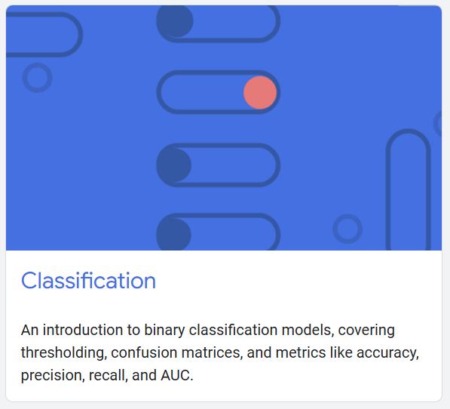
Classification
Notes:
https://developers.google.com/machine-learning/crash-course/classification

Slide 4
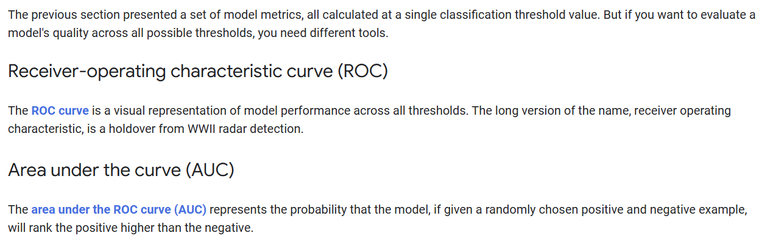

Slide 5
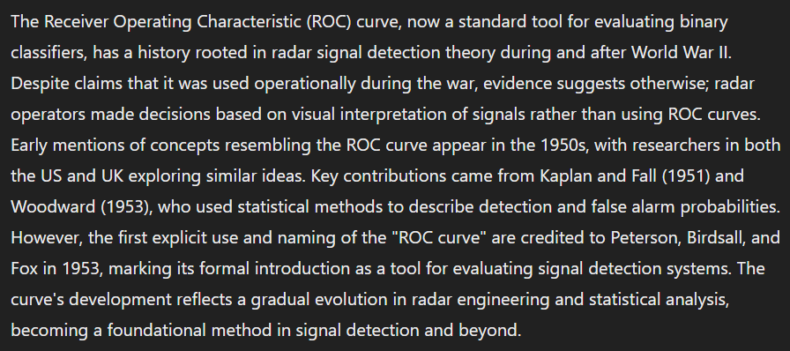
Notes:
https://huijzer.xyz/posts/roc-history/

Slide 6
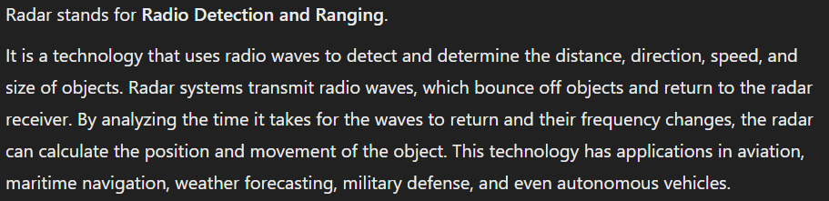

Slide 7
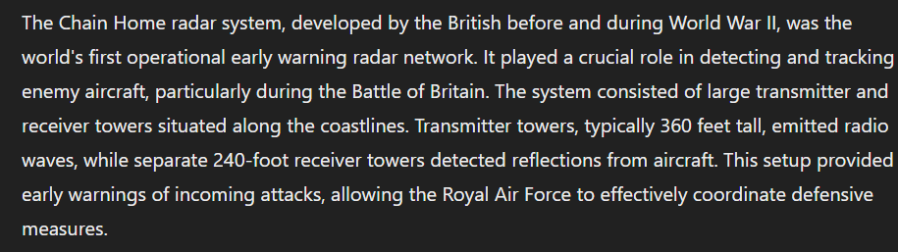

Slide 8
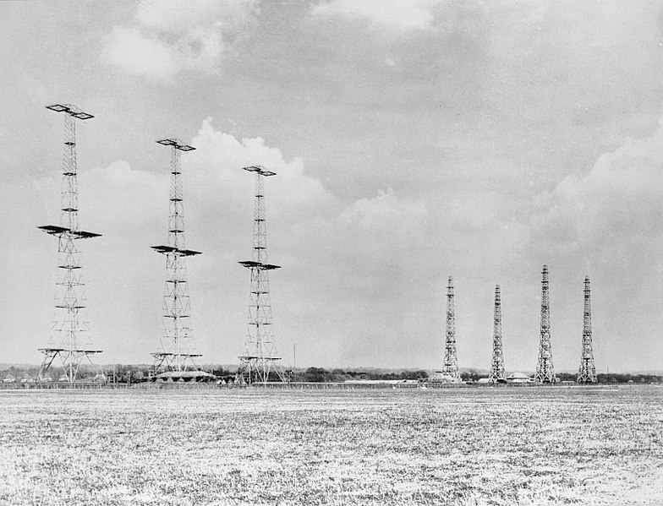

Slide 9
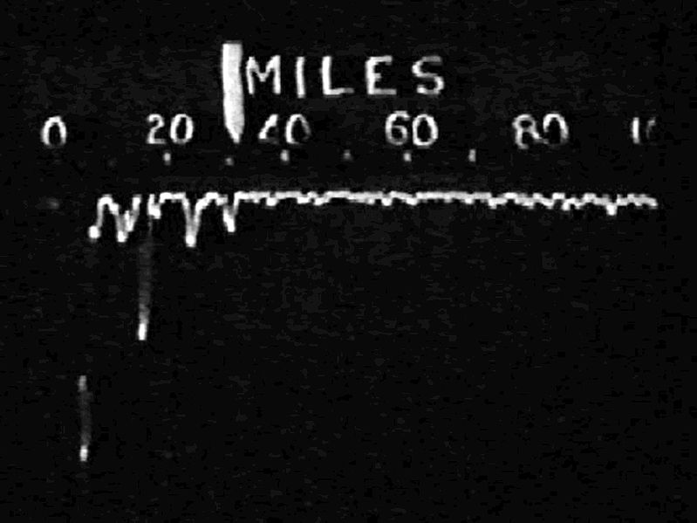

Slide 10
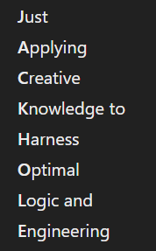

Slide 11
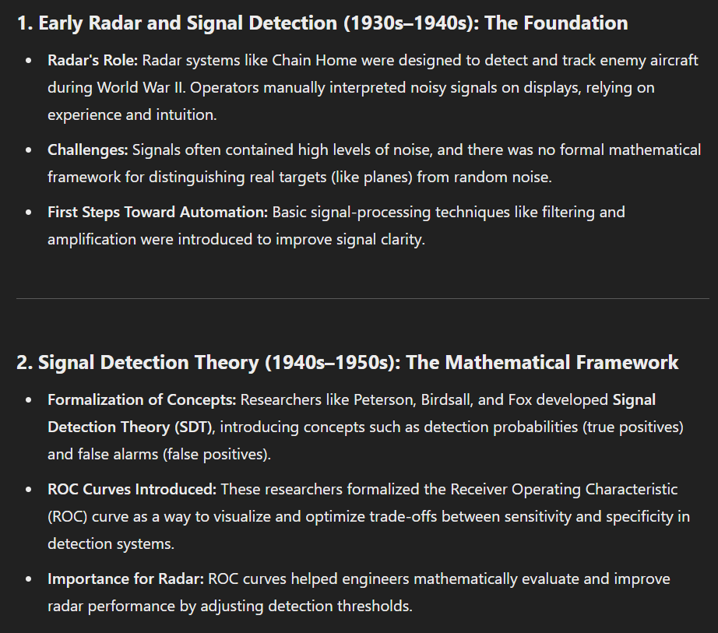

Slide 12
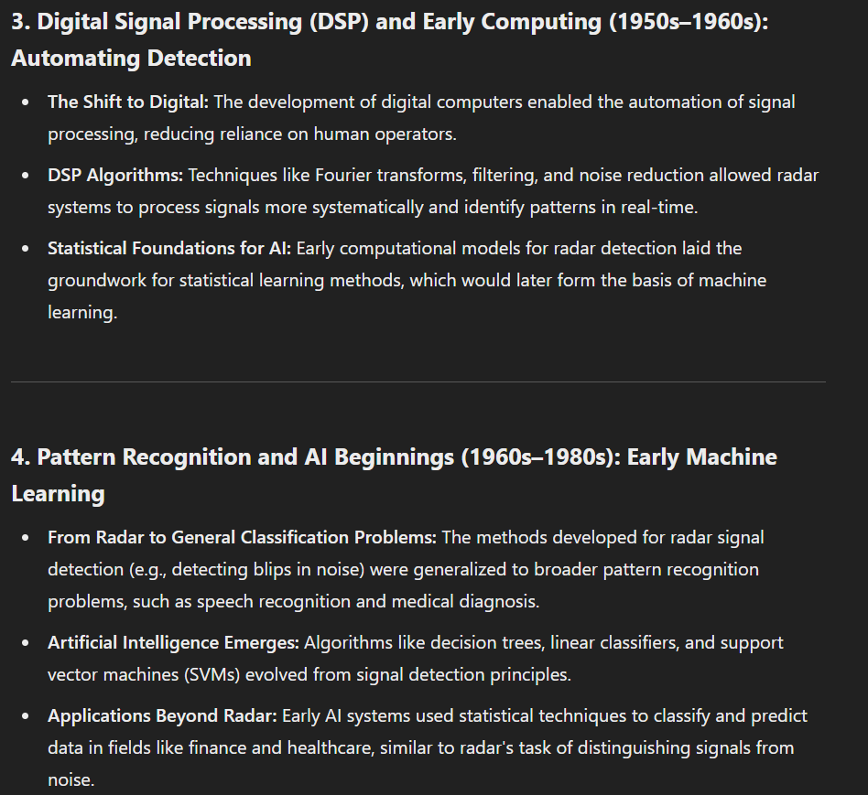

Slide 13
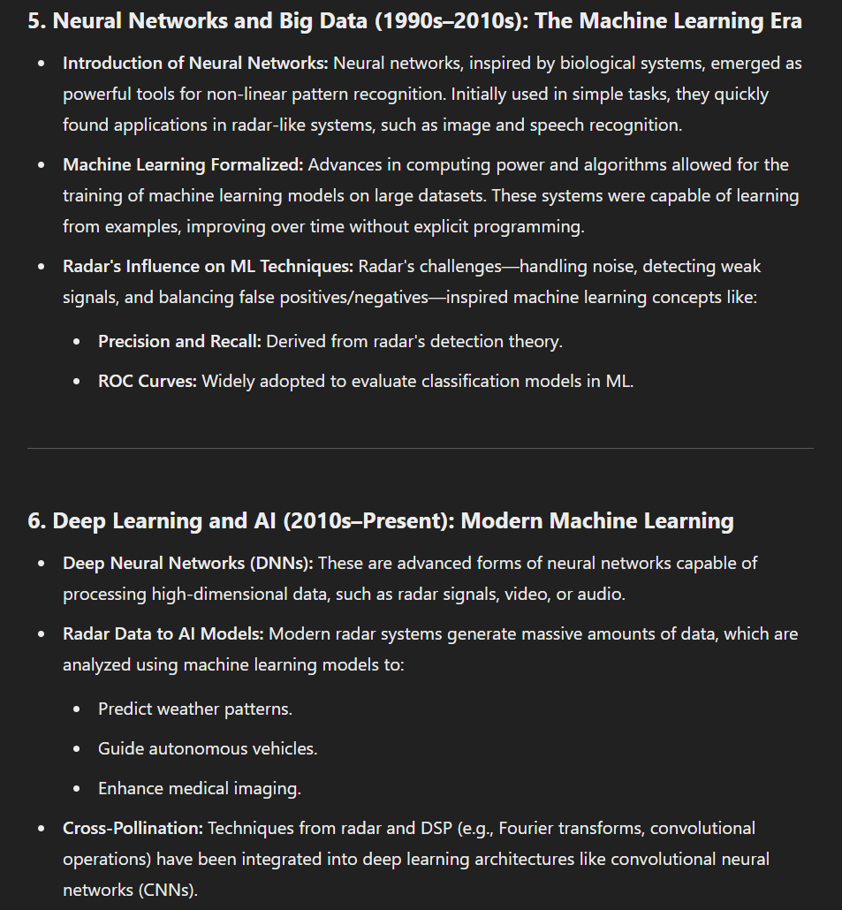

Slide 15
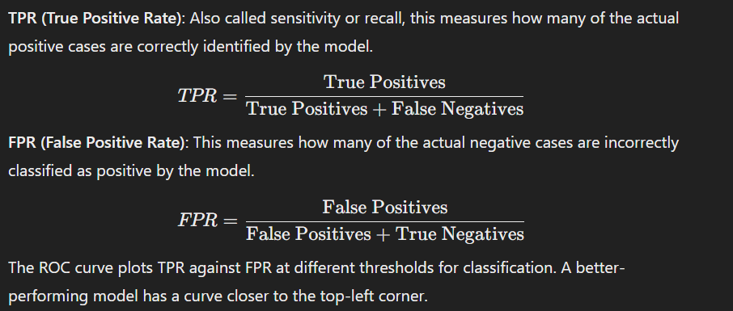

Slide 16
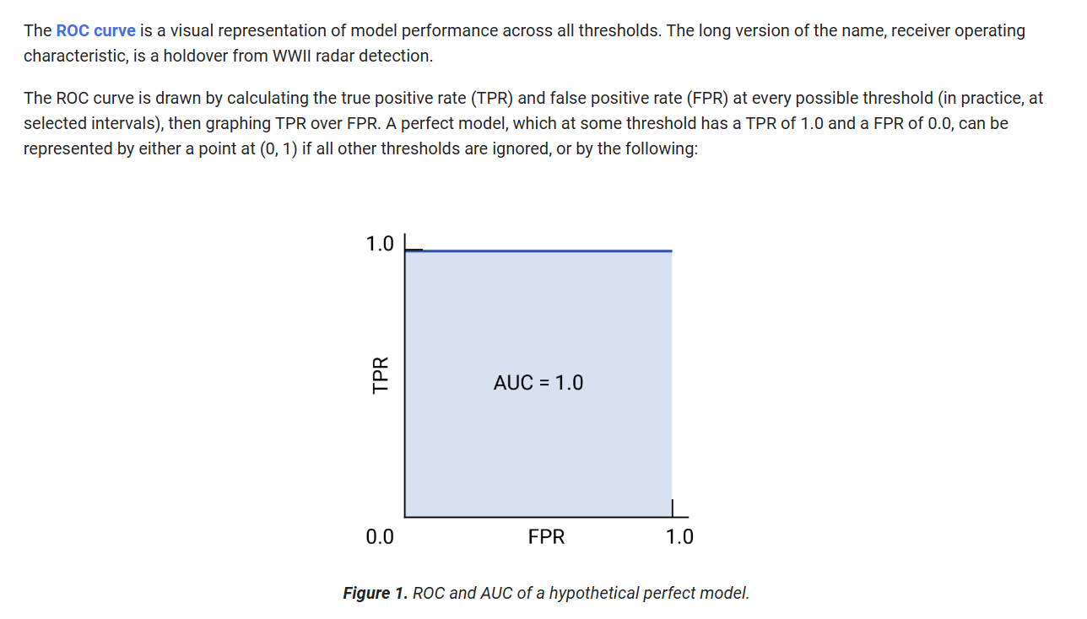
Recall

Slide 17
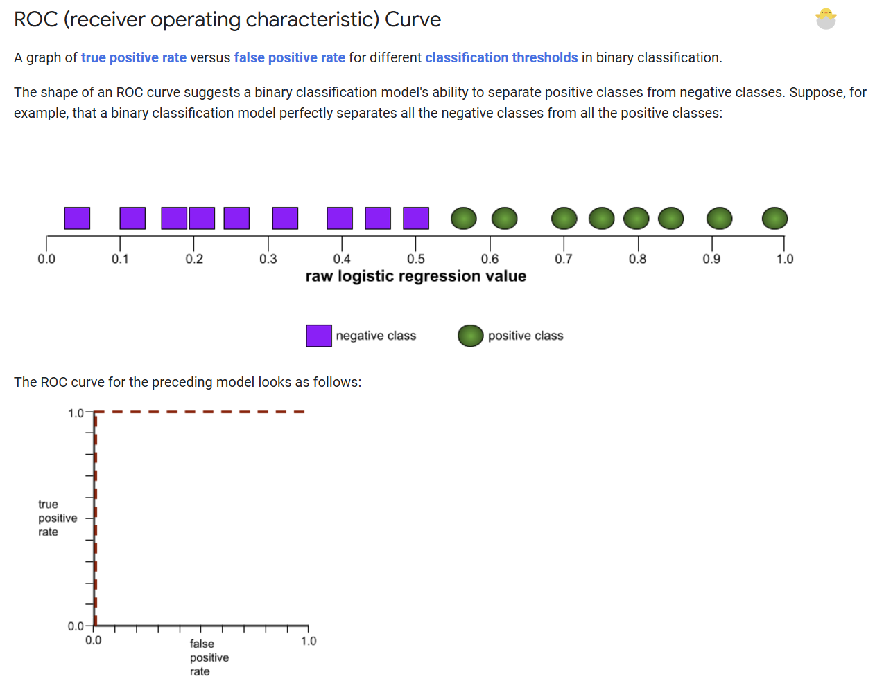

Slide 18
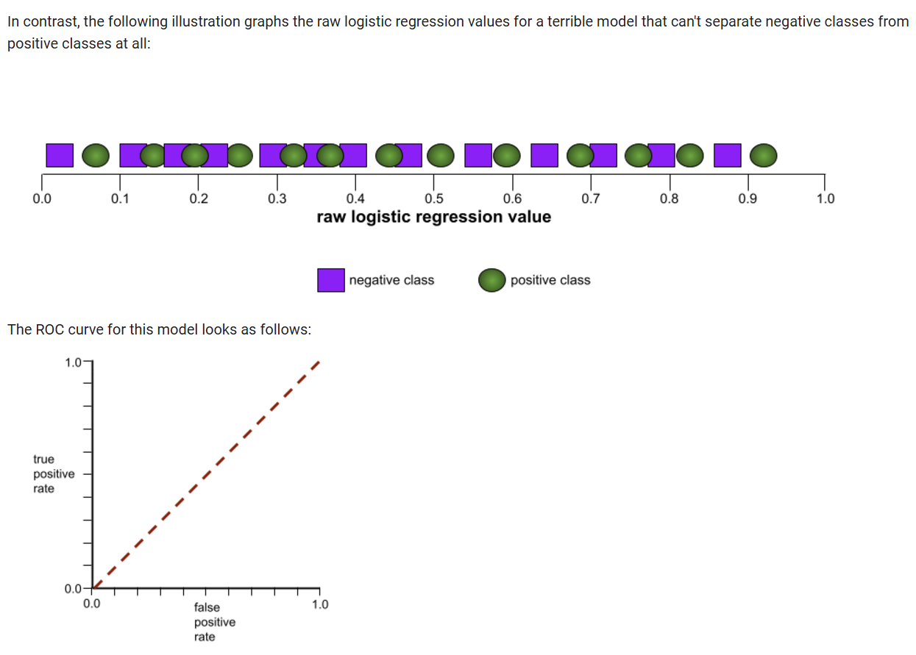

Slide 19
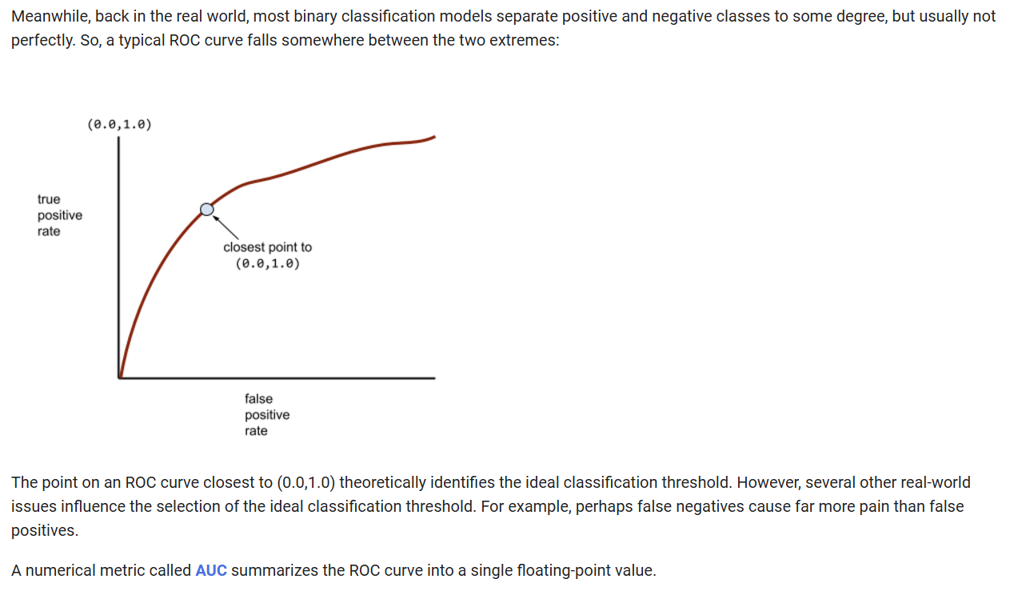

Slide 20
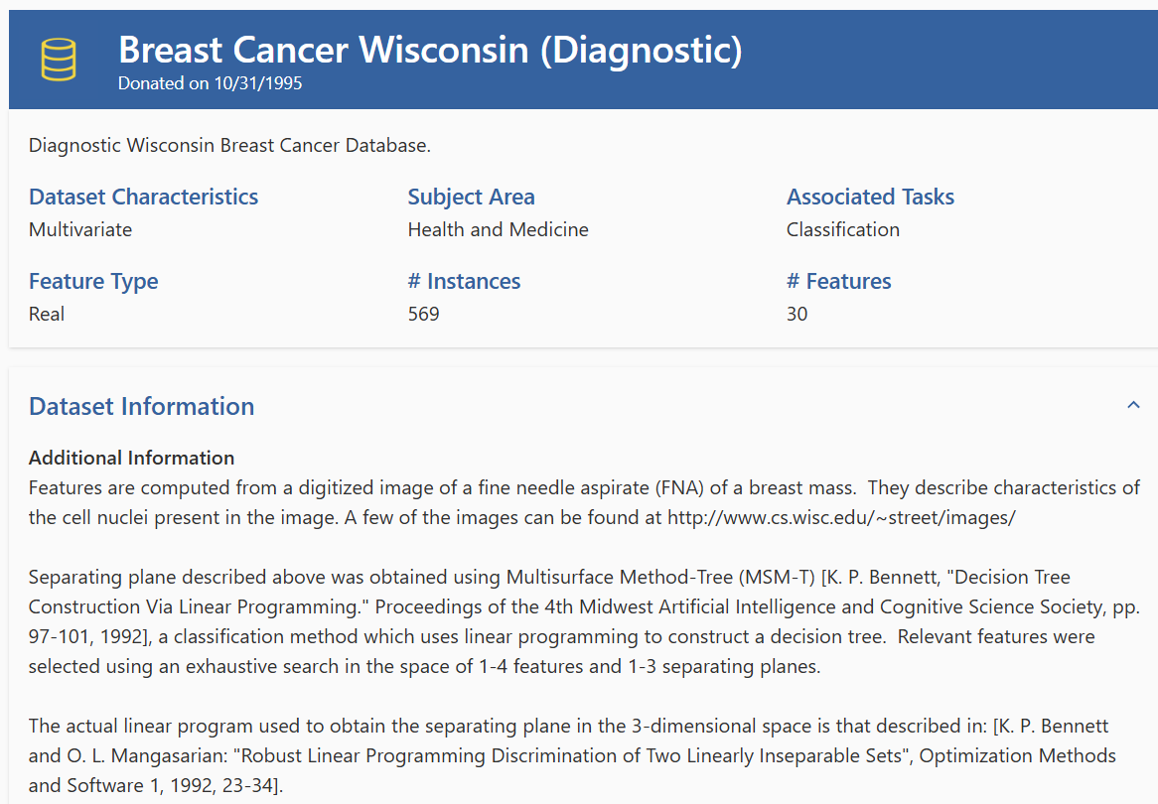
Notes:
https://archive.ics.uci.edu/dataset/17/breast+cancer+wisconsin+diagnostic

Slide 21
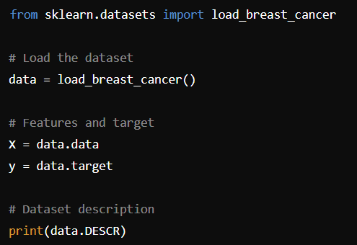

Slide 22
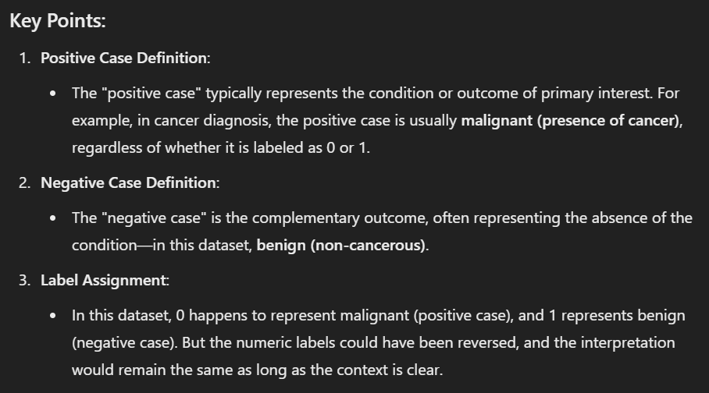

Slide 23
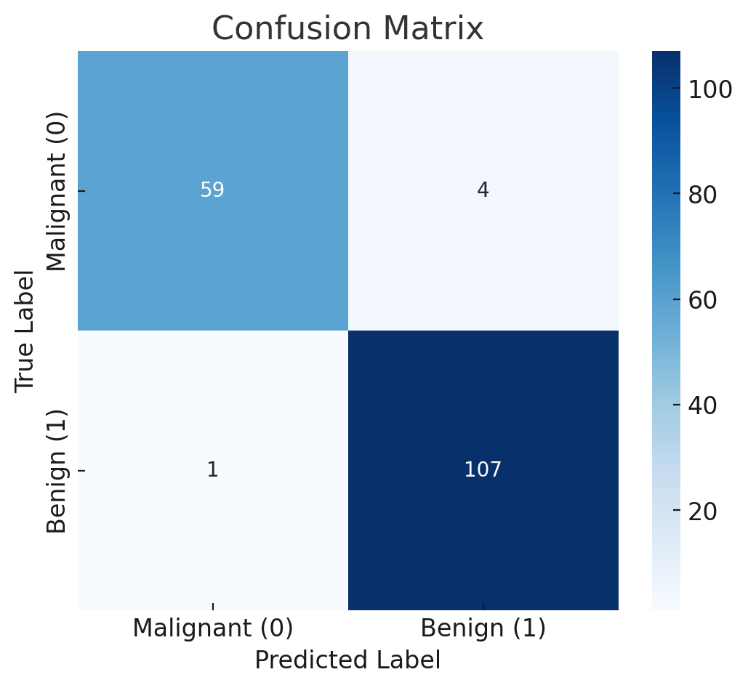

Slide 24
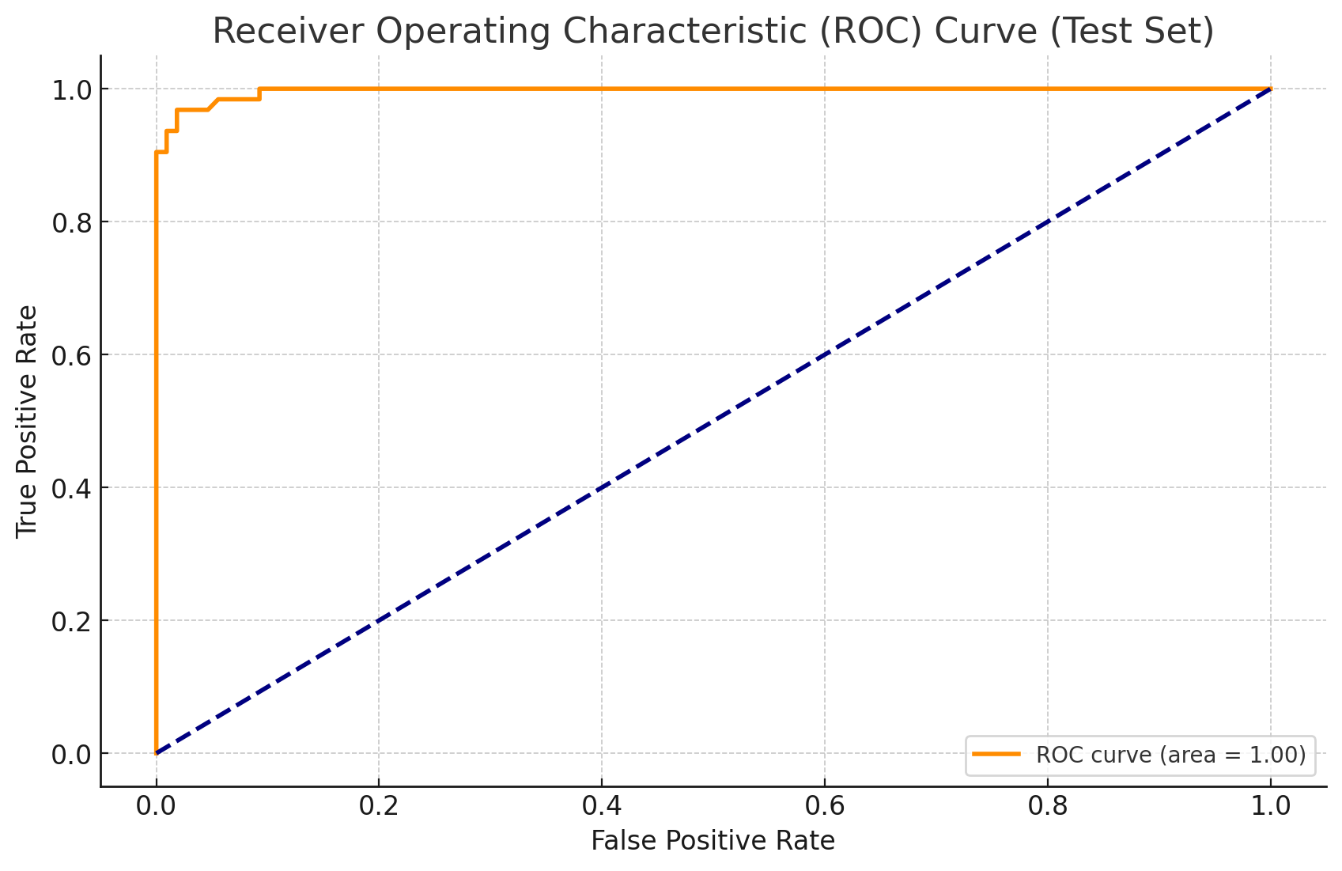

Slide 25
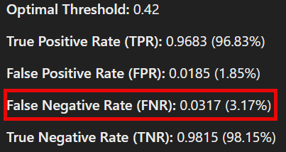

Slide 26
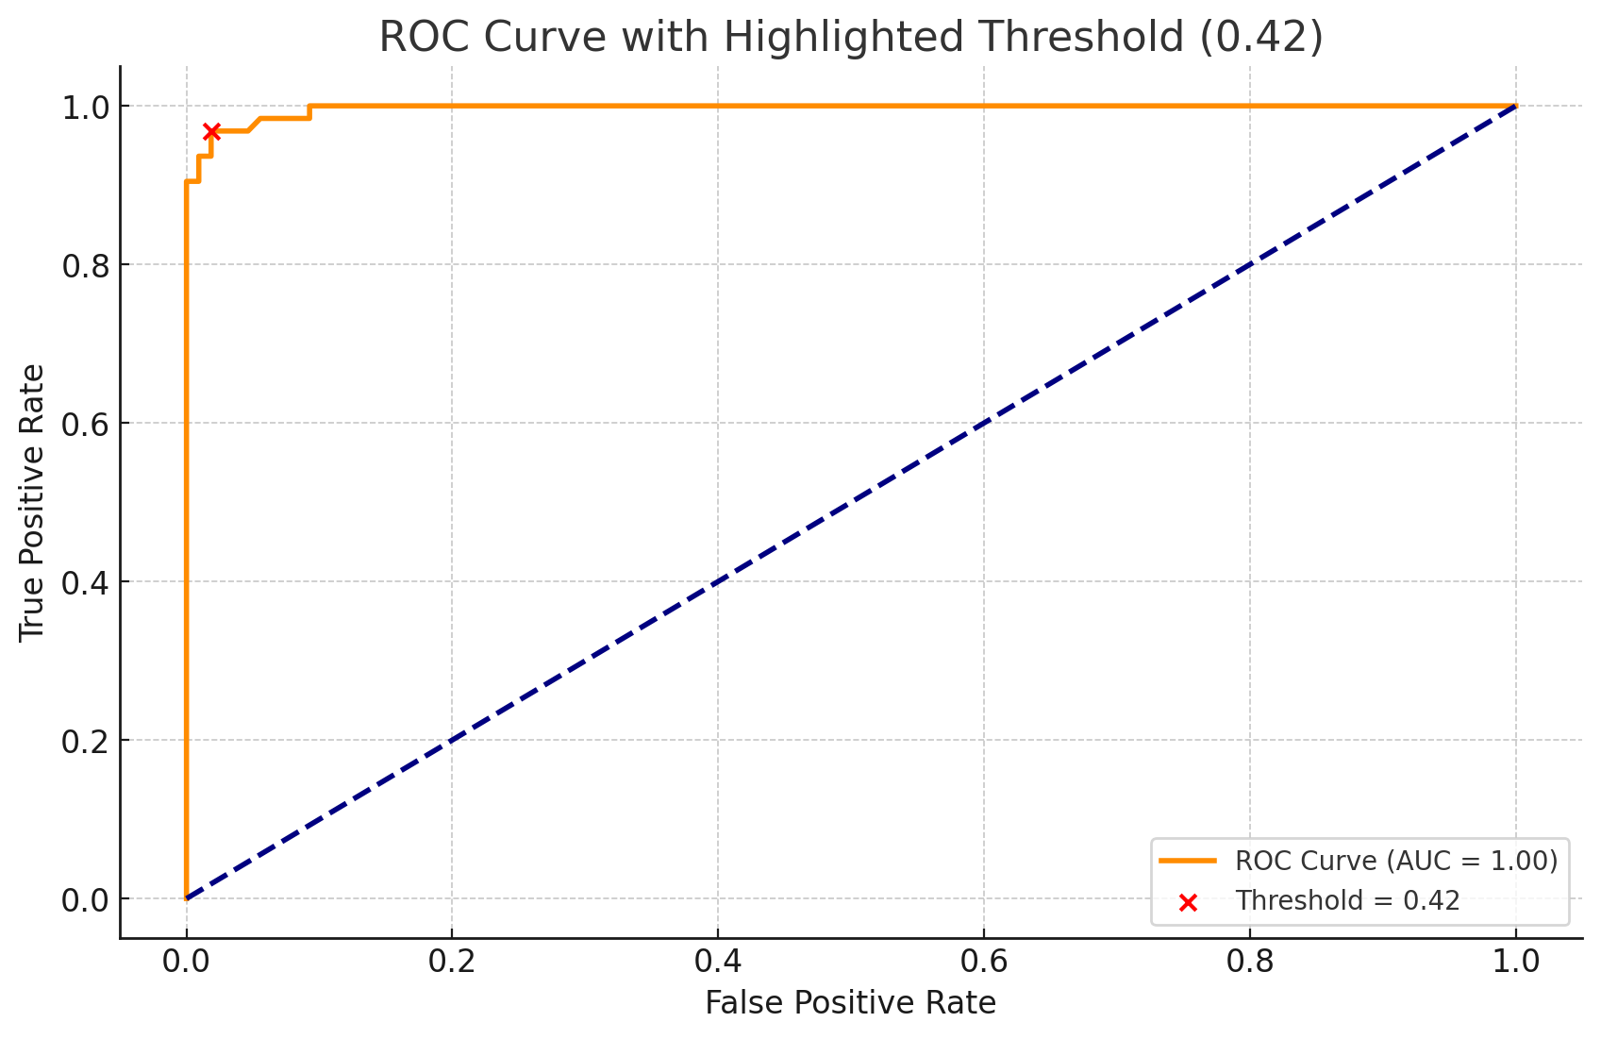

Slide 27

Is an fNr of 0.0317 acceptable?

Slide 28
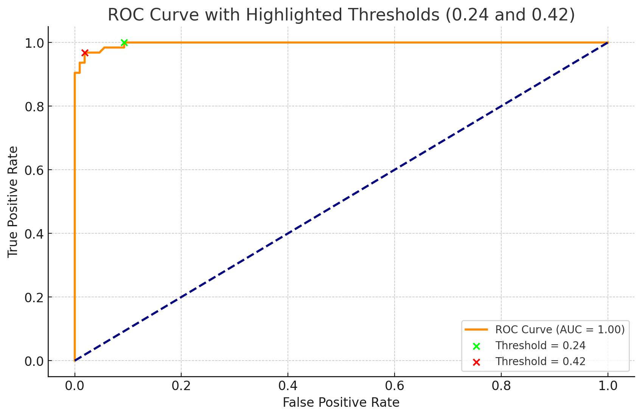

Slide 29
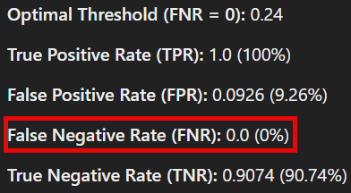

Slide 30
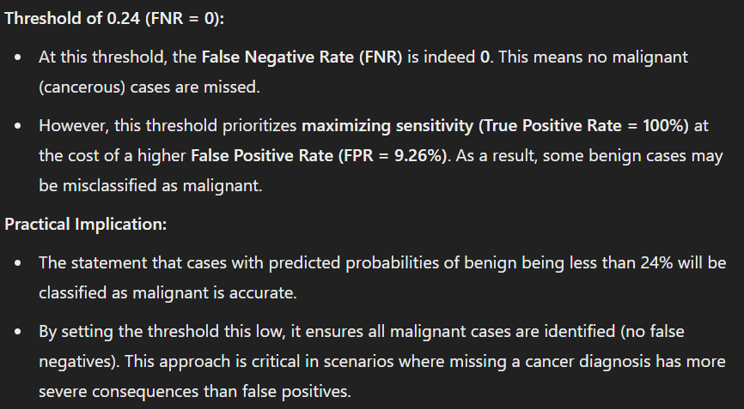

Slide 31
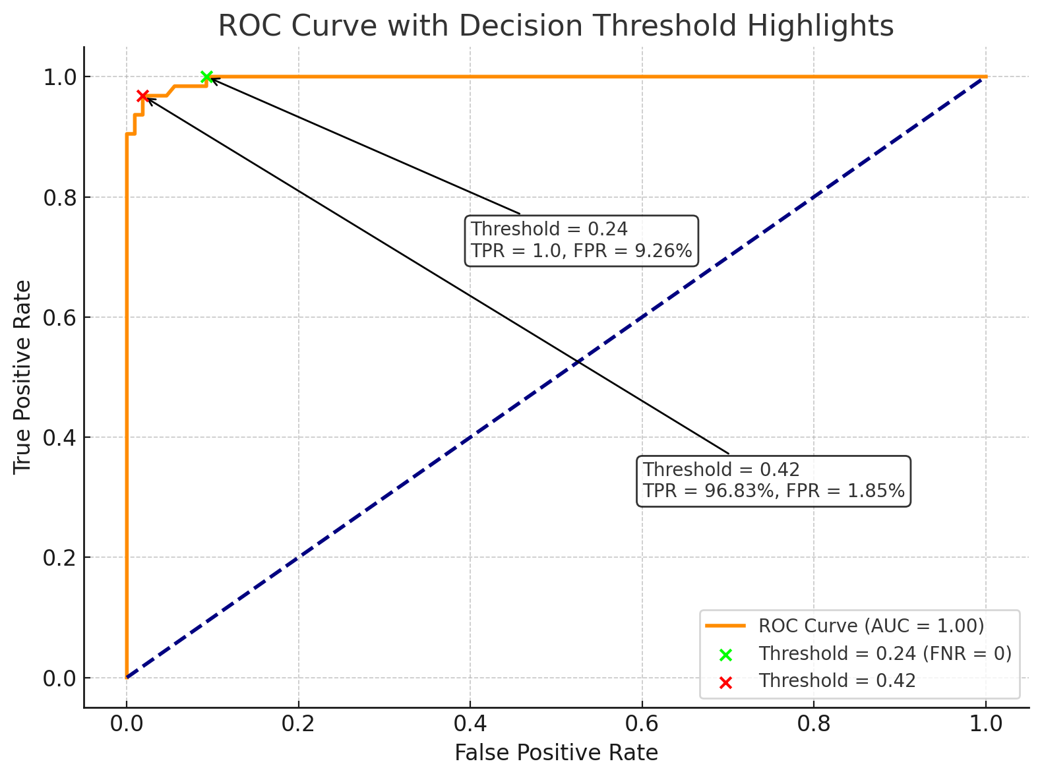

Slide 32
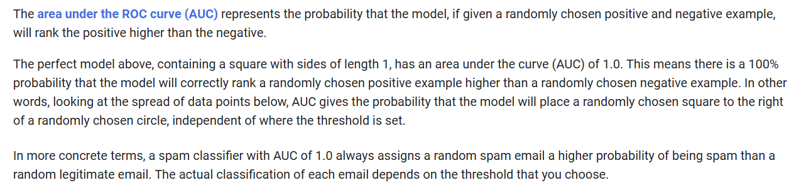

Slide 33
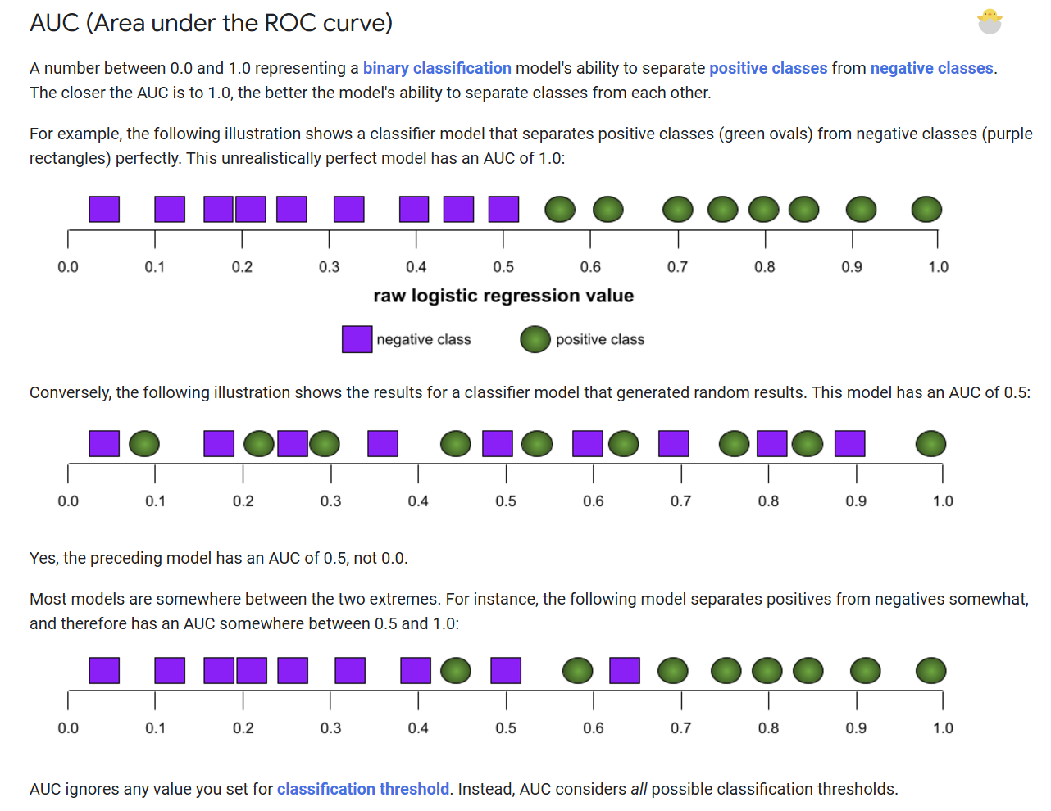

Slide 34
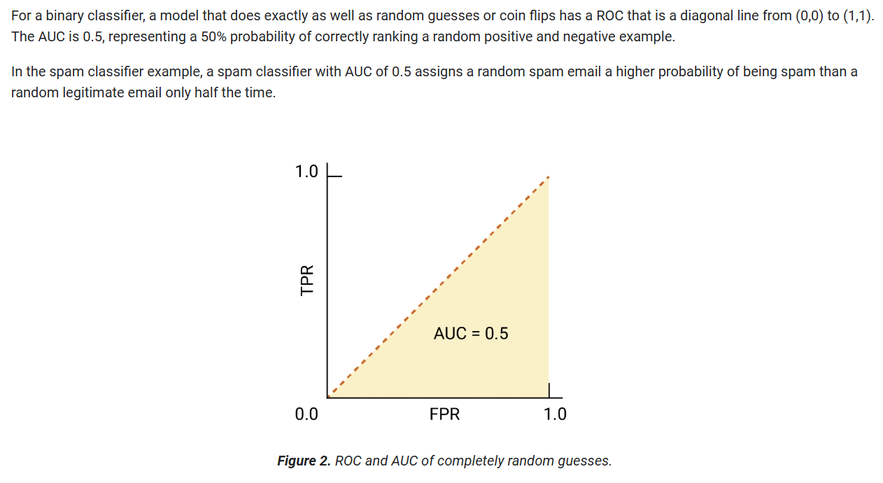

Slide 35
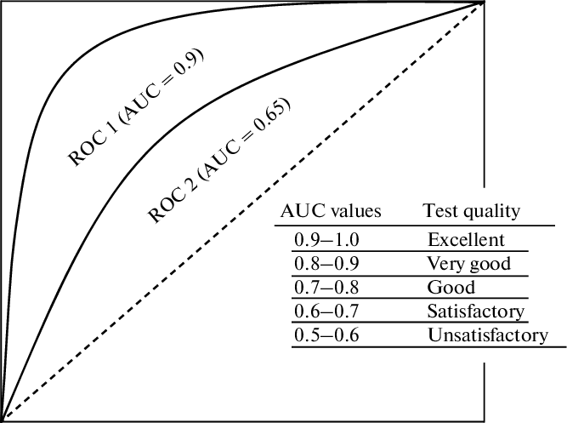

Slide 36
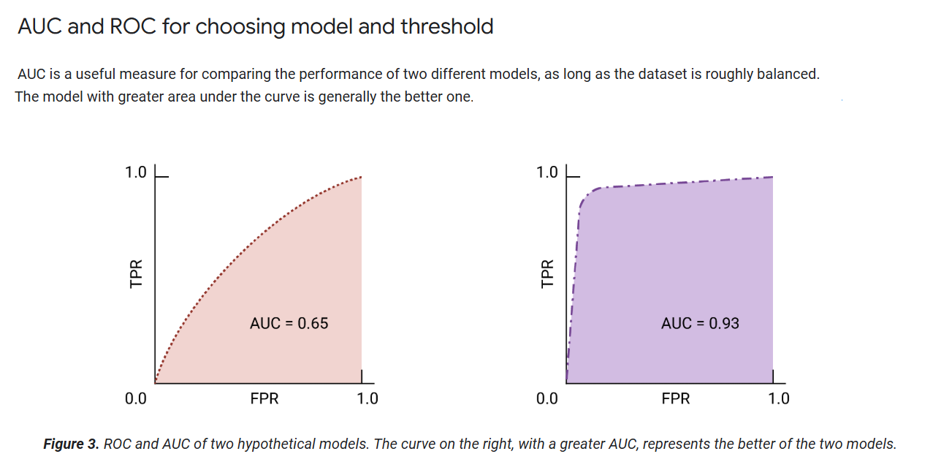

Slide 37
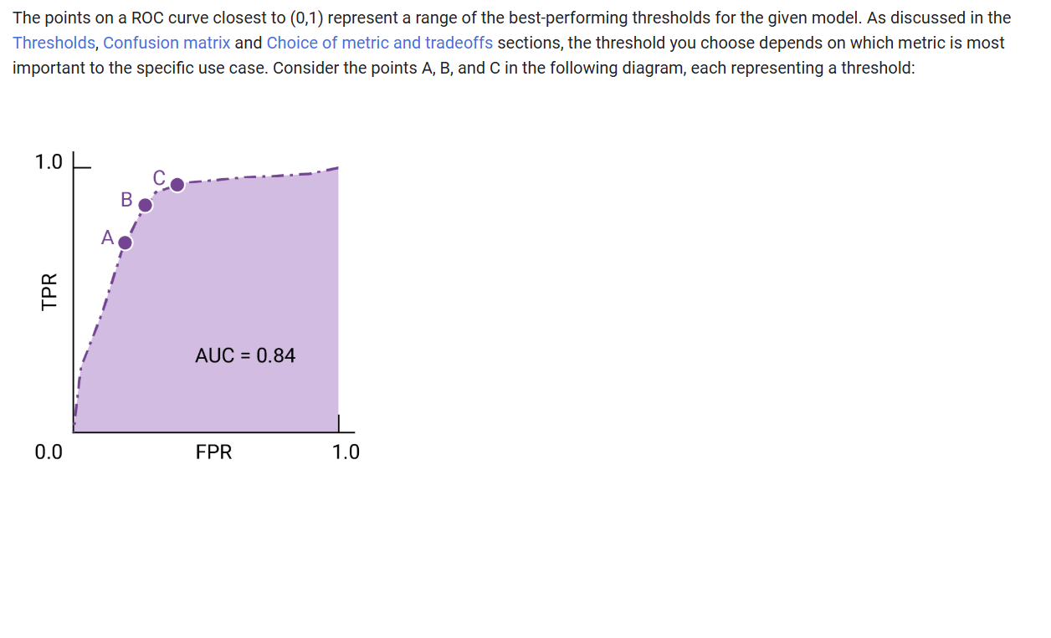
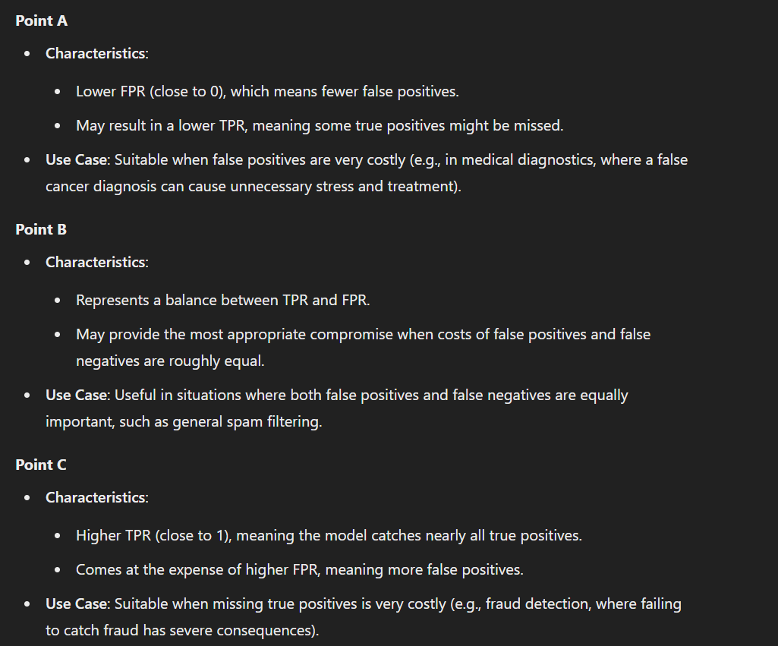

Slide 38




Notes:
https://www.youtube.com/channel/UC35ZpwldGw7ZJ5R-2sLijzw

Slide 39
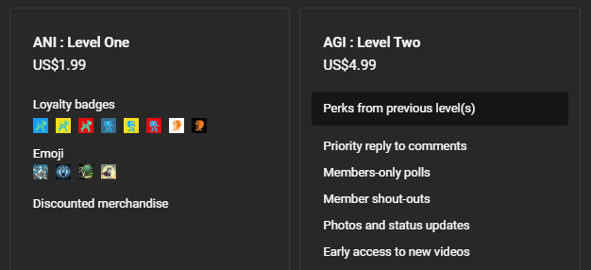

Membership has its privileges
Notes:
https://www.youtube.com/channel/UC35ZpwldGw7ZJ5R-2sLijzw/join

Slide 40

https://www.youtube.com/@AINewsFresh

Slide 41

https://www.youtube.com/@DailyAINewsPodcast

Slide 42

https://www.youtube.com/@AIPapersPodcastDaily

Slide 43
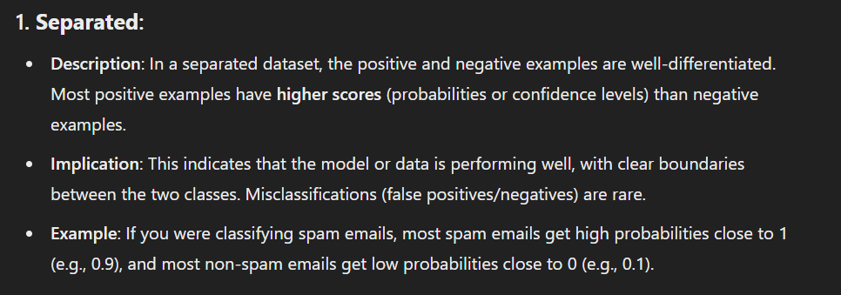
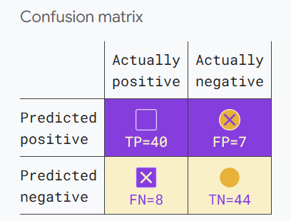

Slide 44
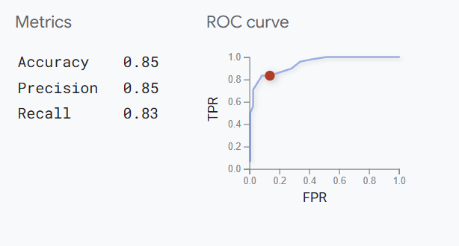
FPR = 0.137
TPR = 0.833

Slide 45
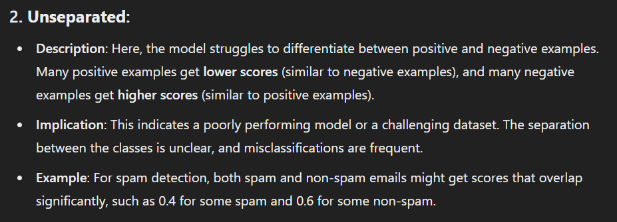
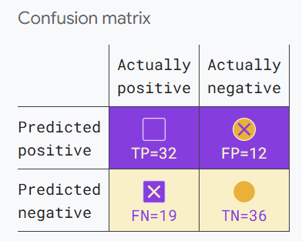

Slide 46
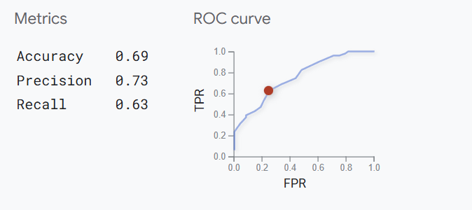
FPR = 0.250
TPR = 0.627

Slide 47
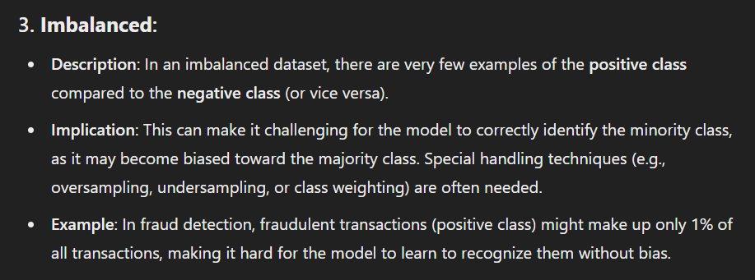
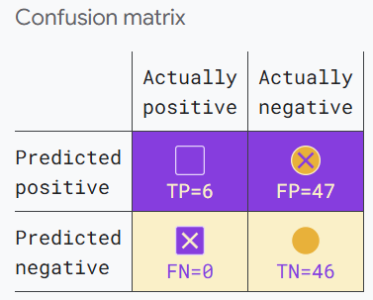

Slide 48
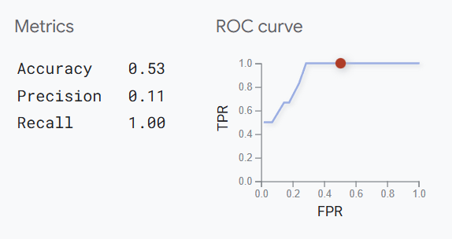
FPR = 0.505
TPR = 1.0

Slide 49
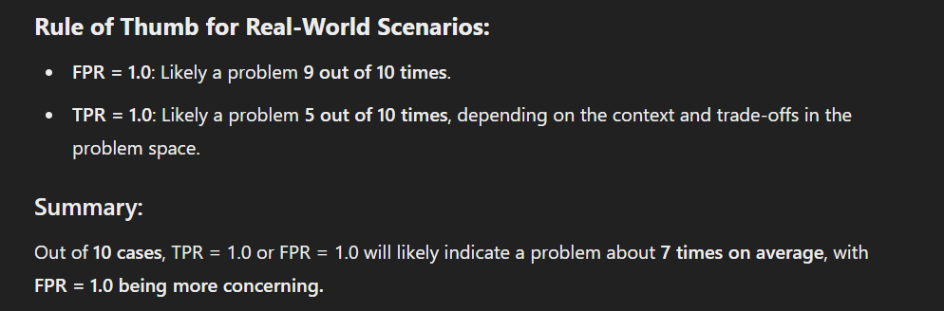

Slide 50
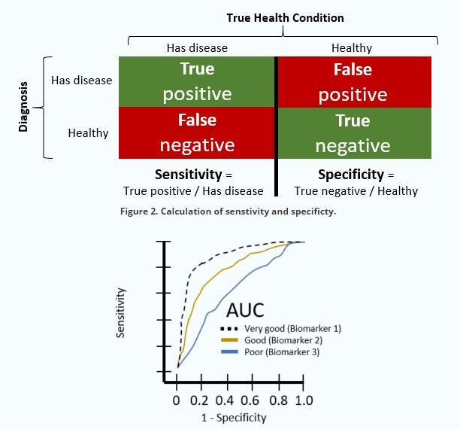
Notes:
https://medium.com/computer-architecture-club/what-is-the-auc-roc-curve-47fbdcbf7a4a

Slide 51
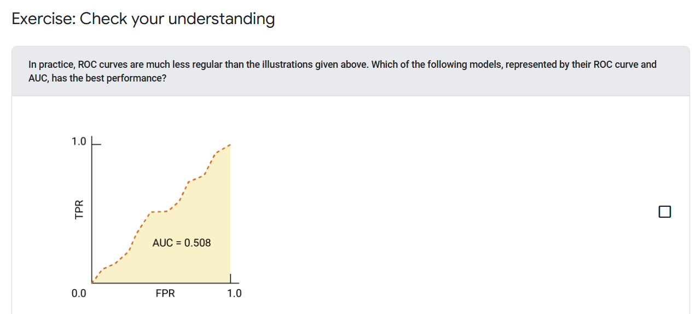
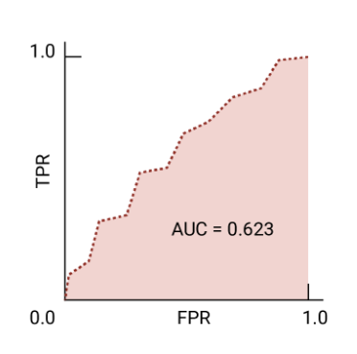
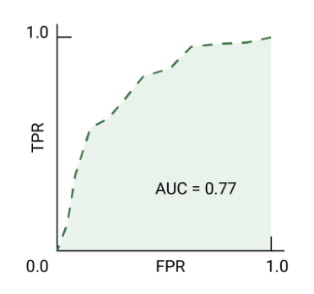
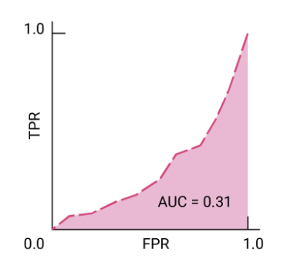

Slide 52


Slide 53





Slide 54


Slide 55


Slide 56


Slide 57


Slide 58


Slide 59

Notes:
https://developers.google.com/machine-learning/glossary

Slide 60


